Slide 1
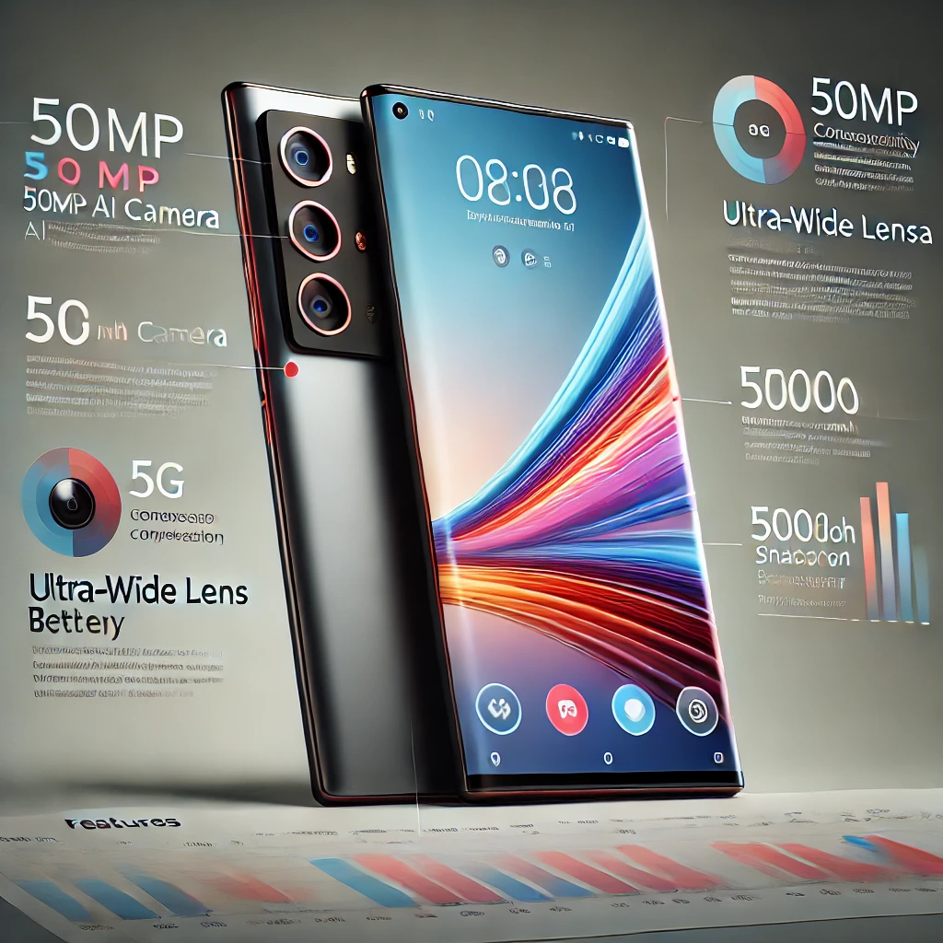
NextHikes IT Solutions Project 4
Feature Extraction and Price Prediction for Mobile Phones
Roshan Borde

Slide 2
Price Prediction for Mobile Phones
Introduction:
The project is based on Mobile companies' historical data.
In this project, we aim to develop a predictive model for mobile phone prices using a comprehensive dataset that contains detailed specifications of various smartphones.
The dataset includes key attributes such as model, color, memory capacity, RAM size, battery capacity, camera specifications (both rear and front), presence of AI lens, mobile height, and processor details.
By analyzing these features, it will help to identify the factors that significantly influence mobile phone pricing.
This predictive model will help in understanding pricing trends, assisting businesses in setting competitive prices.
The project combines data preprocessing, feature engineering, and machine learning techniques to achieve accurate price predictions.

Slide 3
Key Insights & Trends:
The majority of mobile phones are priced between ₹6,000 to ₹18,000, which also represents the highest sales range.
The dataset shows a positively skewed distribution, indicating that a smaller number of high-priced devices significantly increase the average price.
128GB is the most common memory capacity, followed by 64GB and 224GB.
Higher memory capacities are directly linked to increased prices, reflecting consumer demand for more storage in premium models.
4GB RAM is the most preferred choice, followed by 8GB and 6GB.
Consumers largely prefer devices with 4GB and 8GB RAM, aligning with the mid-range market trend.

Slide 4
Key Insights & Trends :
For rear cameras, 50MP is the most popular choice, followed by 13MP and 64MP.
For front cameras, 16MP leads in preference, followed by 5MP and 8MP.
Higher camera resolutions tend to align with premium-priced devices.
The majority of mobile phones are available without an AI lens, indicating lower consumer demand for this feature.
Mobile heights of 16.76 inches, 16.71 inches, and 16.94 inches are the most common.
Larger mobile heights, particularly around 16.00 inches, are linked to higher pricing.
Popular processors include Qualcomm Snapdragon 680, Unisoc T606, Mediatek Helio A22, and Mediatek Dimensity 1080, known for balancing performance and cost.

Slide 5
Key Insights & Trends :
Consumers prefer black, blue, and green colored phones.
Black, blue, and gold models are generally priced higher.
Green and cyan tend to be associated with lower-cost devices.
Phones in grouped color categories often belong to higher price segments.
Key Relationships:
Memory (0.69), Front Camera in MP (0.72), and RAM (0.65) have the strongest positive correlation with price.
Rear Camera (0.54) has a moderate impact, indicating it’s less significant than memory and front camera quality.
Mobile Height (0.13) shows a weak correlation, implying minimal influence on price.

Slide 6
Challenges & Address them:
Inconsistent Data:
Challenge- The dataset contained inconsistent data in 'Rear Camera' and 'Front Camera’ with mixed of string and integer.
Address-for handling theses inconsistent three steps are followed, Renamed the columns name 'Rear Camera in MP' and 'Front Camera in MP then removed the string by using str.replace function. In Third step convert the data types into integer by using astype function.
Colours columns contained multiple colours feature:
Challenge- Near about 99% of colours column was containing the multiple colours feature, which was difficult to analysis.
Address- Categorised Colours Columns by grouping colours in broader categories. Name of colours are given according to their broader categories by using def function.

Slide 7
Challenges & Address them:
Outliers:
Challenge- Many features like 'Memory, Battery_, Rear Camera in MP, Front Camera in MP, Mobile Height, Prize are containing the outliers.
Address - IQR(Inter Quartile Range) Method is used to calculate outliers and capp with Min_value for Lower Value and Max_value for Upper Value..
Normalization of dataset:
Challenge- Many categorical features and numerical features need to be normalized.
Address –. To address these one hot encoding and StanderScaler are used to normalize the dataset.
Identifying which features are most to influences the mobile prize:
Challenge- To Identifying features which are most to influences the mobile prize.
Address- After implementing the five algorithm and comparing the which is giving the most accurate result then most difficult job was Identifying features which are influencing the mobile prize. So feature_importances_ function are used to identifying the most influencing the features for mobile prize.

Slide 8
Conclusion:
The Front Camera in MP is the most significant factor influencing mobile prices, reflecting consumer demand for better selfies, video calls, and social media content.
Memory ranks second, highlighting the preference for ample storage.
RAM also plays a key role, impacting performance and multitasking.
Mobile Height and Rear Camera in MP have moderate influence.
Models like Google Pixel 7 and processors such as Google Tensor G2, Mediatek Dimensity 1080, and Snapdragon 778G+ further impact pricing, indicating premium features and performance are valued.

Slide 9
Recommendations to Mobile Company:
Camera Enhancement Strategy: Invest in improving front camera features such as higher megapixels, advanced AI enhancements, and night mode. Emphasize camera capabilities in marketing campaigns to attract camera-conscious consumers.
Memory and Storage Optimization: Offer multiple storage variants (e.g., 64GB, 128GB, 256GB) to cater to diverse customer needs. Highlight expandable storage options to appeal to budget-conscious buyers.
Performance Enhancement: Integrate higher RAM configurations in mid-range and premium models for better multitasking and gaming experiences. Incorporate efficient processors like Qualcomm Snapdragon and Mediatek Dimensity to enhance performance.
Design and Build Improvements: Focus on sleek, ergonomic designs with optimal screen sizes to improve consumer appeal.
Brand and Processor Positioning: Market premium devices featuring powerful processors (e.g., Google Tensor G2, Snapdragon 778G+) for superior performance and gaming potential. Collaborate with renowned chipset brands to strengthen product positioning.

Slide 10
Recommendations:
Targeted Marketing: Focus campaigns on showcasing improved front camera features and memory enhancements as key price determinants. Highlight model-specific strengths (e.g., Google Pixel's camera technology or Infinix Zero’s unique selling points) to attract distinct customer segments.

Slide 11
References:
https://builtin.com/articles/feature-engineering
https://www.geeksforgeeks.org/regression-in-machine-learning/
https://www.ibm.com/think/topics/supervised-learning
Linear regression SVM Regressor KNN Regressor Decision Tree Regressor Random Forest Regressor
https://www.youtube.com/watch?v=U5oCv3JKWKA&t=173s
https://www.youtube.com/watch?v=mnKm3YP56PY

Slide 12


